Slide 1
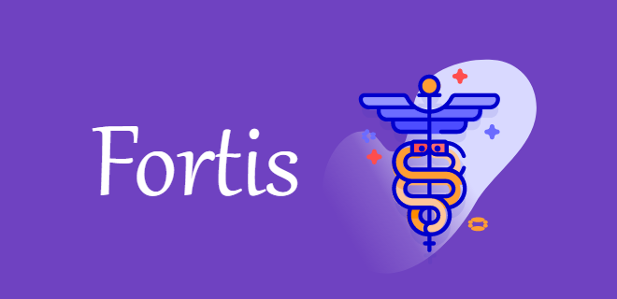
PRATIAN SKILLASSURE ASSESSMENT FRAMEWORK

Slide 2
PROBLEM-NEED
Unable to identify the estimated time of consultation
Longer waiting time
Delay than scheduled time
Patient unaware about the pre-requisites for consultation, which eventually
leads to anxiety and annoyance in patients.

Slide 3
Need
Envision a system which ensures flawless patient encounter at the outpatient
department.
A patient centric system, that will enable a he Ensure seamless patient experience, by achieving
Channelization of patients’ flow
Ensuring right education
Identify the estimated time of service (ETS) for each patient and society having wellness as a goal.

Slide 4
Key Features
User Registration
User Authentication
Doctor Appointment
Video Consulting Appointment
Check Availability of bed
Emergency Application for patient
Buy Medicines Online
Nurse Consult for minor problems

Slide 5
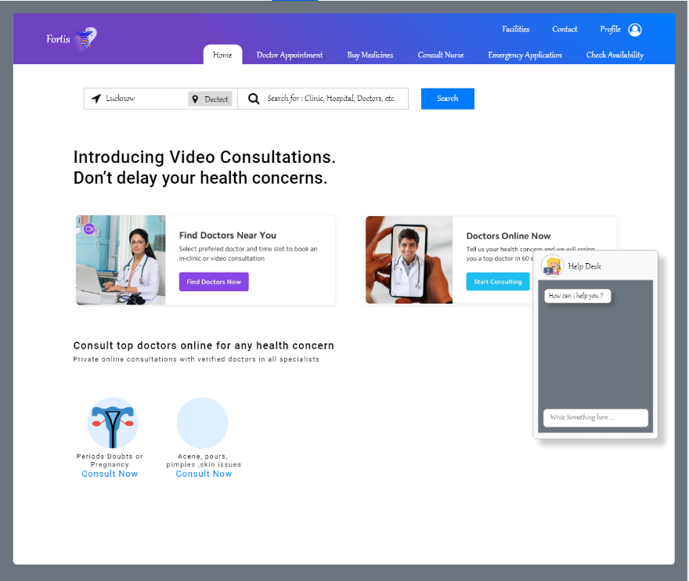
WIREFRAMES FOR FEATURES

Slide 6
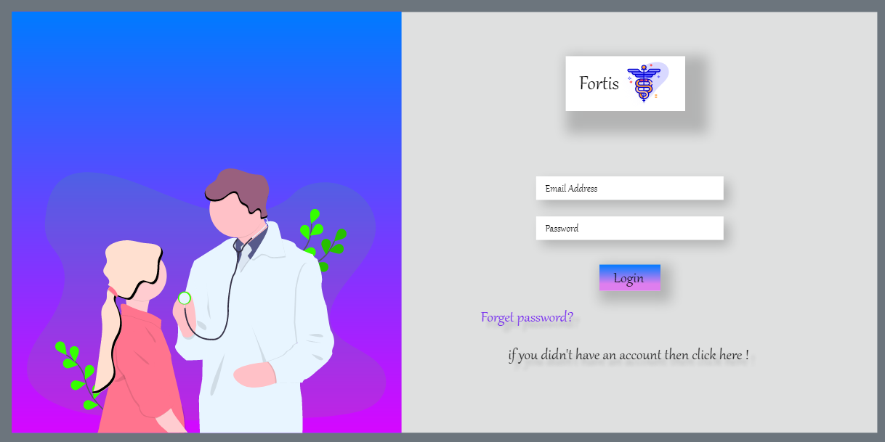
WIREFRAMES FOR FEATURES

Slide 7
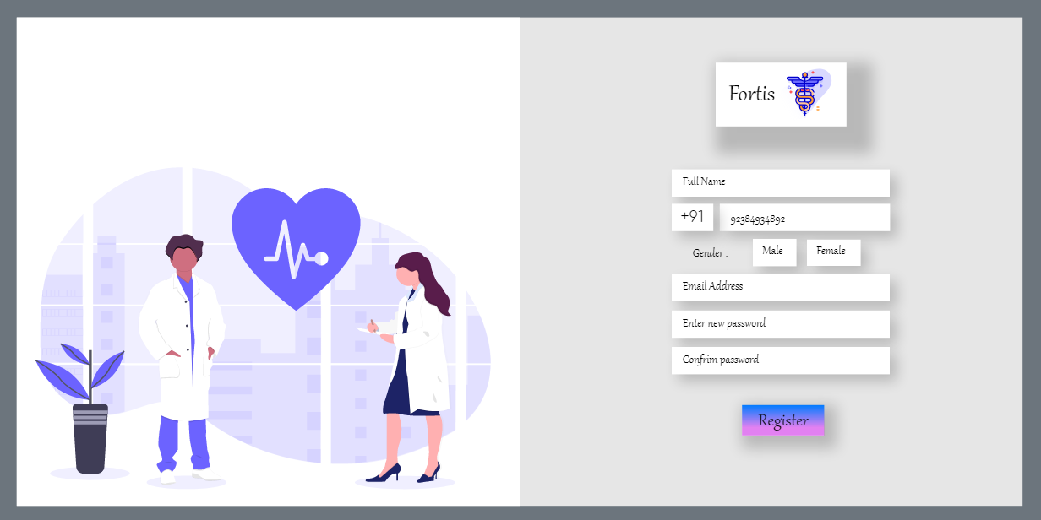
WIREFRAMES FOR FEATURES

Slide 8
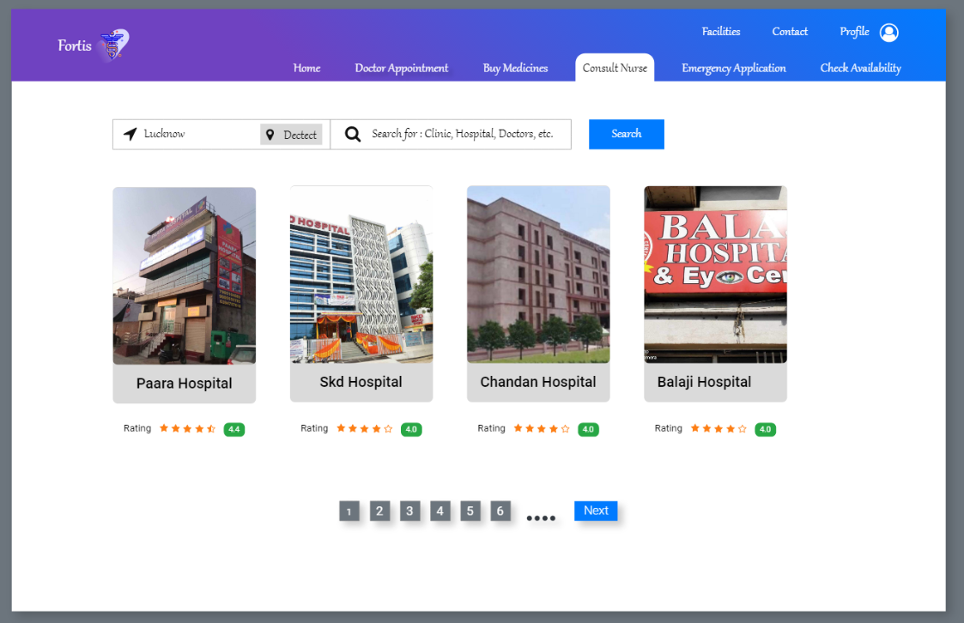
WIREFRAMES FOR FEATURES

Slide 9
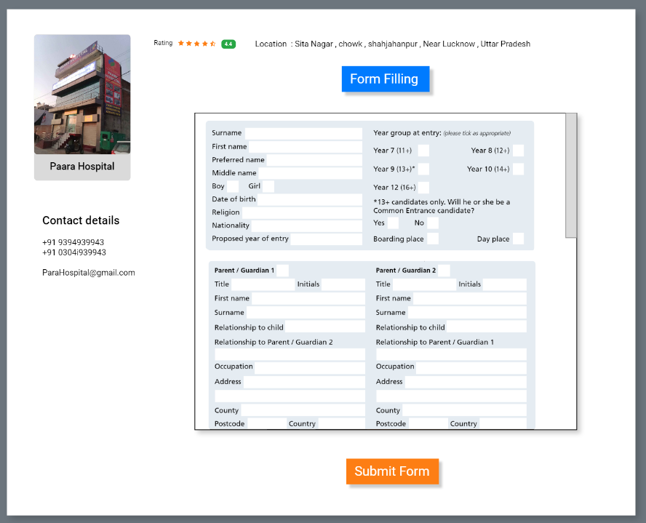
WIREFRAMES FOR FEATURES

Slide 10
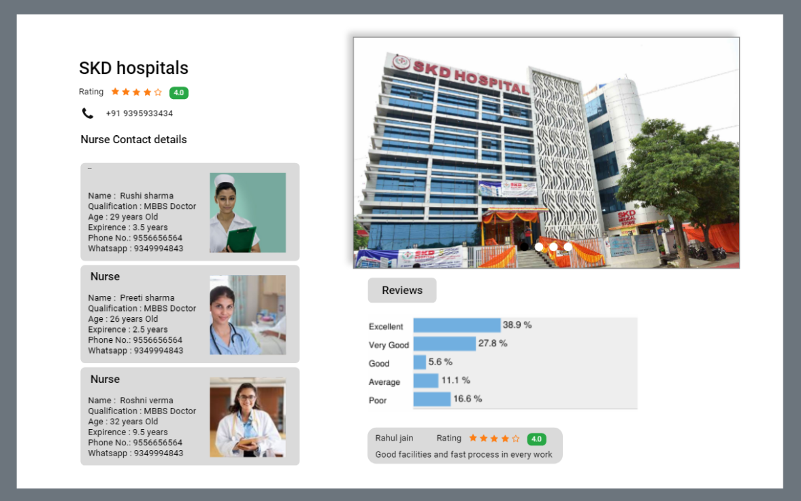
WIREFRAMES FOR FEATURES

Slide 11
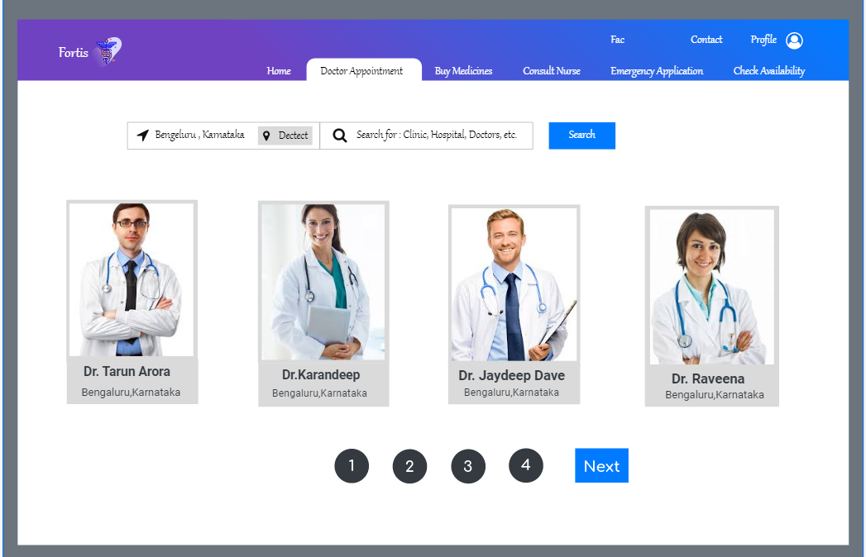
WIREFRAME FOR FEATURES

Slide 12
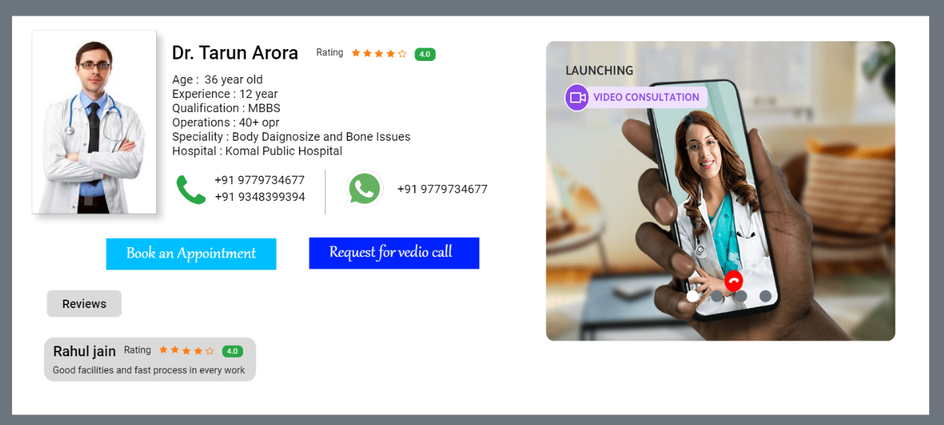
WIREFRAMES FOR FEATURES

Slide 13
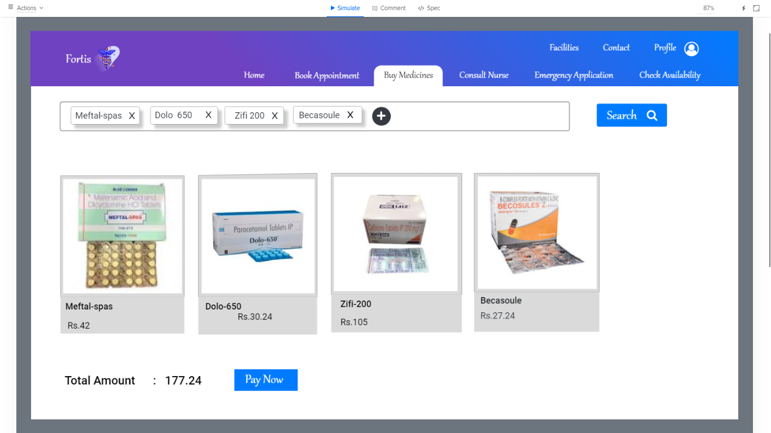
WIRE FEATURES FOR FEATURES

Slide 14
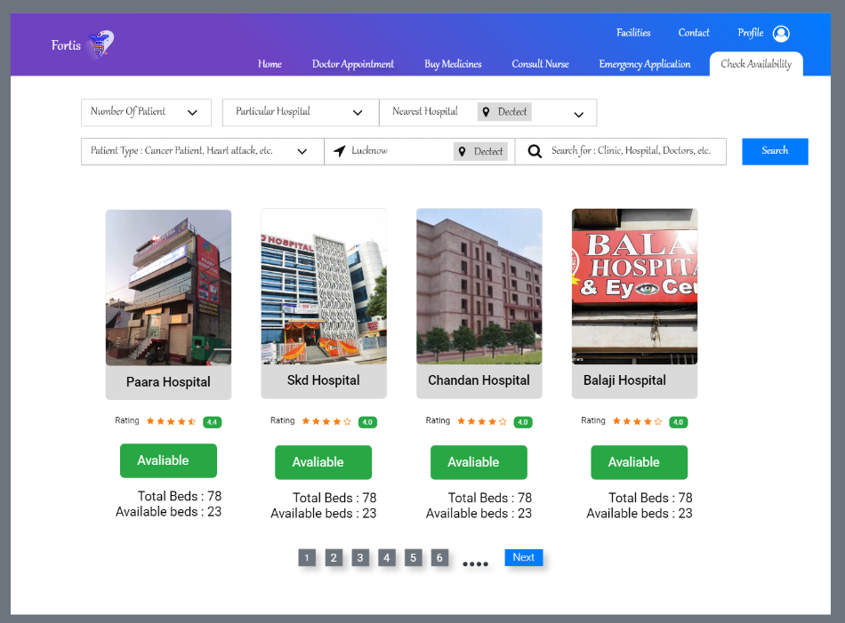
WIRE FEATURES FOR FEATURES

Slide 15
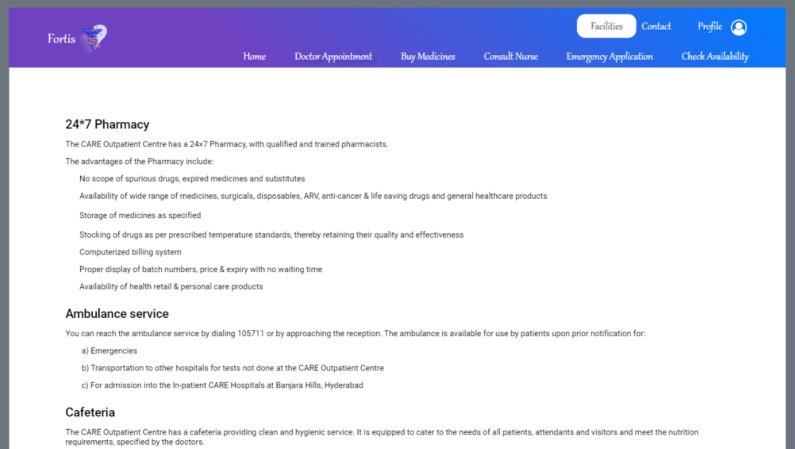
WIREFRAMES FOR FEATURES

Slide 16
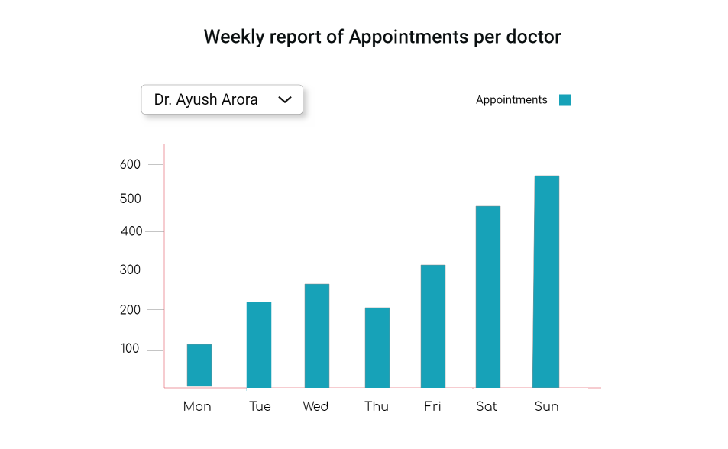
WIREFRAMES FOR REPORTS AND DASHBOARDS

Slide 17
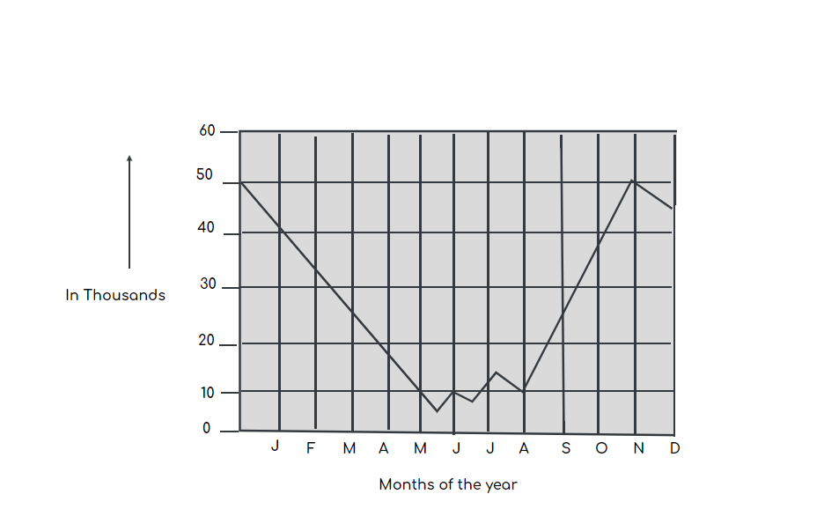
WIREFRAMES FOR REPORTS AND DASHBOARD
Bed Availability

Slide 18
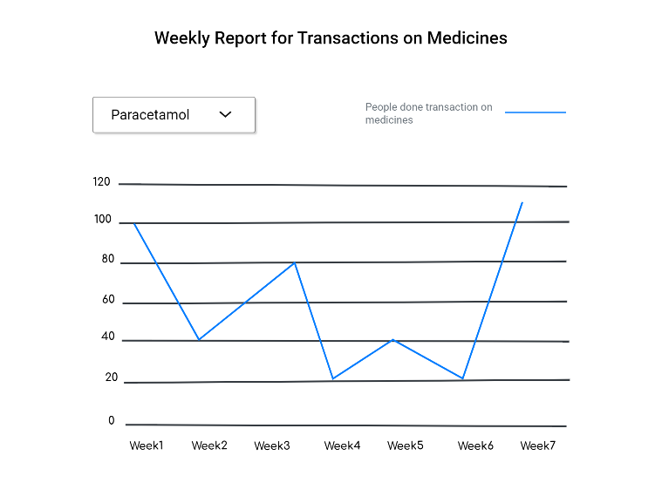
WIREFRAMES FOR REPORTS AD DASHBOARD

Slide 19


